Slide 1
Science 8
Chapter 2-Lesson 3—Acceleration = Mass/Force Notes

Slide 2
Math Skills
Newton's Second Law Equation

Slide 3
Date

Slide 4
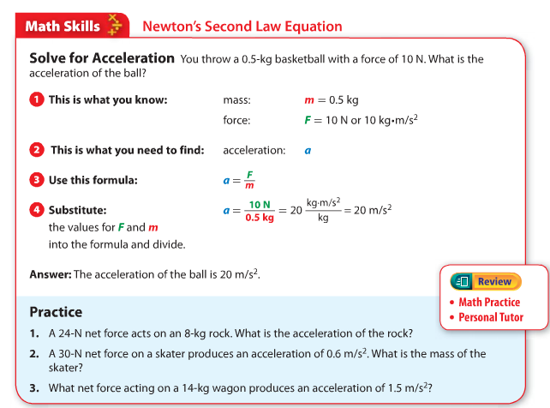
Open your books to page 65!

Slide 5
Notes
a = acceleration (m/s/s) or (m/s ²)
m = mass (kg)
F = force (N)
A newton is the same as ${kg ∗m/s }^{2}$
a = F/m

Slide 6
Example
Solve for Acceleration
You throw a 0.5-kg basketball with a force of 10N. What is the acceleration of the ball?

Slide 7
This is what you know.
mass
m = 0.5 kg
force
F = 10 N or 10 kg * m/s²

Slide 8
This is what you need to find:
acceleration: a

Slide 9
Use this formula:
$a= \frac{F}{m}$

Slide 10
Substitute:
the values for F and m into the formula and divide.
$a= \frac{10 N}{0.5 kg}$
$a=20 \frac{kg ∗m/s²}{kg}$
$a=20 m/s²$

Slide 11
Answer:
The acceleration for the ball is $20 m/s²$.

Slide 12
Practice

Slide 13
Problem #1
A 24-N net force acts on an 8-kg rock. What is the acceleration of the rock?
What do we know?
Force = 24N
Mass = 8 kg
What do we need to find?
acceleration

Slide 14
Problem #1
What is the formula?
$a= \frac{F}{m}$
Substitute in known values.
$a= \frac{24}{8}$
$a=3 m/s²$

Slide 15
Problem #2
A 30-N net force on a skater produces an acceleration of 0.6 $m/s²$. What is the mass of the skater?
What do we know?
Force = 30N
Acceleration = 0.6 $m/s²$
What do we need to find?
Mass
Can we put the numbers in the same place as the last time?

Slide 16
Problem #2
What is the formula?
$a= \frac{F}{m}$
Substitute in known values.
$6= \frac{30}{m}$
$Watch out!$ There is a variable in the denominator!
Multiple by the reciprocal of m. Do this to both sides of the equation.
$(\frac{m}{1}$)(6) = ($\frac{30}{m}$)($\frac{m}{1}$)
6m = 30
m= 5 kg

Slide 17
Problem #3
What net force acting on a 14-kg wagon produces an acceleration of 1.5 $m/s²$?
What do we know?
mass = 14 kg
acceleration = 1.5 $m/s²$
What do we need to find?
force

Slide 18
Problem #3
What is the formula?
$a= \frac{F}{m}$
Substitute in known values.
$1.5= \frac{F}{14}$
$\left(1.5\right)\left(14\right)=F$
$F=21 N$

Slide 19
One More Problem!
Go to page 81.

Slide 21
Problem #1
What is the formula?
$a= \frac{F}{m}$
Substitute in known values.
$2.5= \frac{17}{m}$
$Watch out!$ There is a variable in the denominator!
Multiple by the reciprocal of m. Do this to both sides of the equation.
$(\frac{m}{1}$)(2.5) = ($\frac{17}{m}$)($\frac{m}{1}$)
2.5m = 17
m= 6.8 kg

Slide 22
Review
Newton’s second law of motion states that the acceleration of an object equals the net force on the object divided by the object’s mass. This can be shown by the equation below, where a = acceleration (in m/s²), F = net force (N), and m = mass (in kg).
You can rearrange the equation to solve for force or mass.
$F=m∗a$
$m= \frac{F}{a}$

Slide 23
Example
If a 4.5-kg bowling ball is rolled down the bowling lane with a force of 15 N, what is the acceleration of the ball?
$a= \frac{F}{m}$
Substitute the known values to solve the equation.
$a= \frac{15 N}{4.5 kg}$
$a=3.3 m/s²$

Slide 24
The End!

